Slide 1
DEEP LEARNING AND APPLICATIONS MR20-1CS0158
UNIT III
Artificial Neural Networks: Introduction, Perceptron Training Rule, Gradient Descent Rule.
Gradient Descent and Back propagation: Gradient Descent, Stochastic Gradient Descent, Back propagation, Some problems in ANN Optimization and Regularization: Over fitting and Capacity, Cross Validation, Feature Selection, Regularization, Hyper parameters.
Text Book
1. Goodfellow, I., Bengio, Y., and Courville, A., Deep Learning, MIT Press, 2016

Slide 2
Perceptron Training Rule

Slide 3
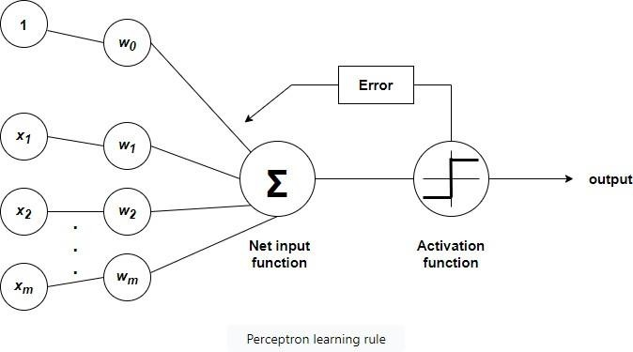
Perceptron learning rule
A perceptron takes inputs, modifies the inputs using certain weights, and then uses a function to output the final result. This is shown in the diagram below

Slide 4
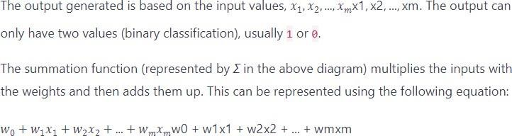
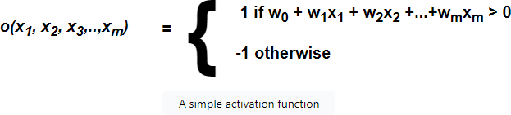

Slide 5
Activation function
The activation function converts the numerical output of the weighting function to 1 or 0.
Error and adjustments
Before we can use a perceptron to predict output, it is trained using labeled data. For each input in the training set, we compute the output. If the observed output does not match the expected output, we calculate the error.
Initially, we usually set the weights to randomly selected numbers.
We can then use the error to tweak the weights in favor of the expected output. We repeat this process until the perceptron gives a high degree of accuracy in its output.
How much we adjust our weights is controlled by the learning rate of the perceptron.

Slide 6
Gradient Descent Rule

Slide 7

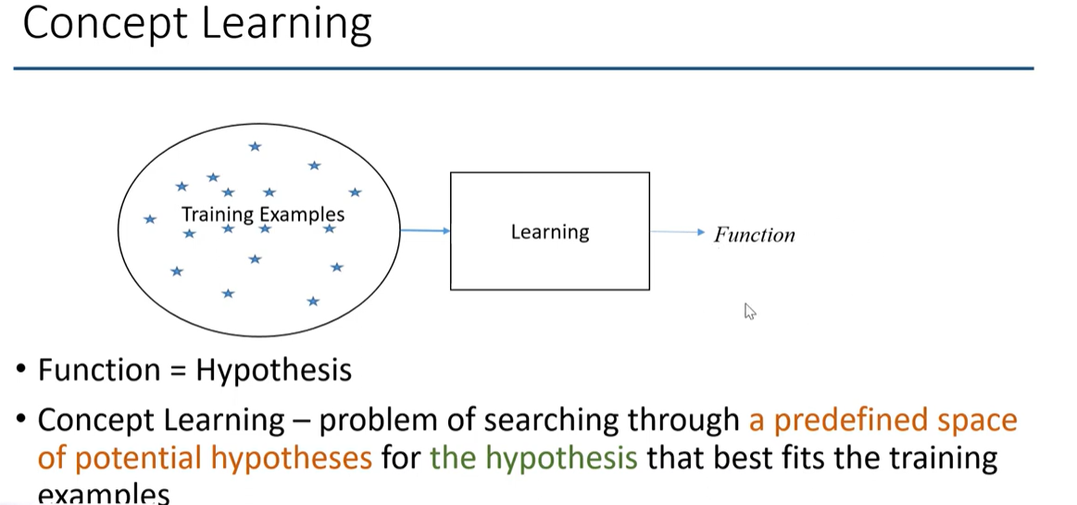
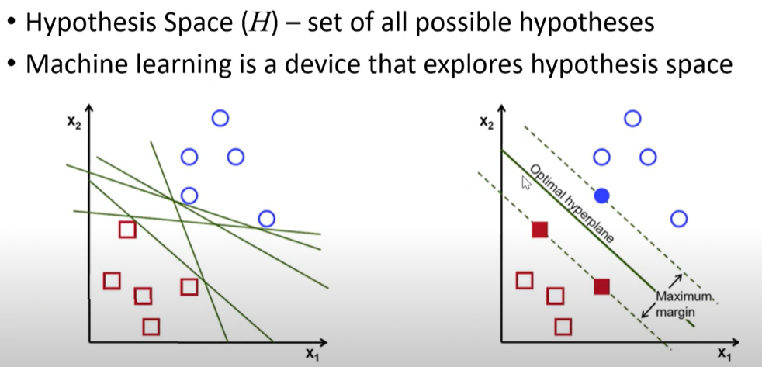
(Potential Solutions)

Slide 8
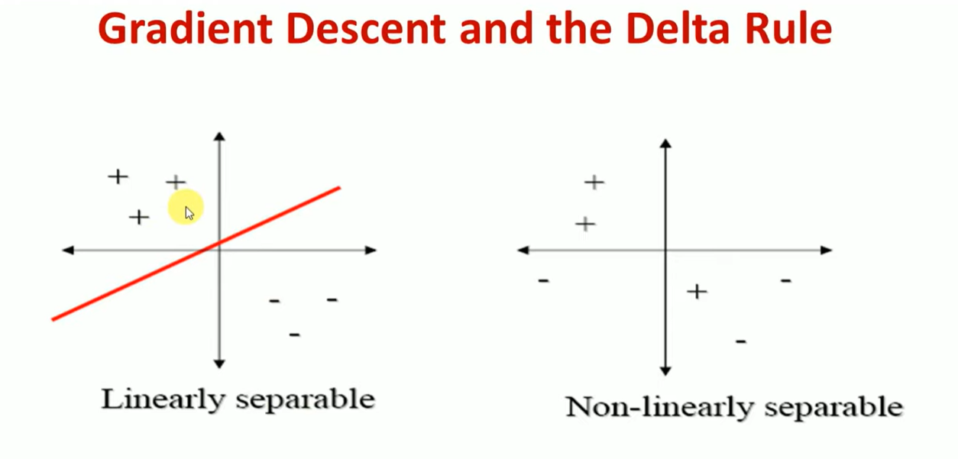

Slide 9
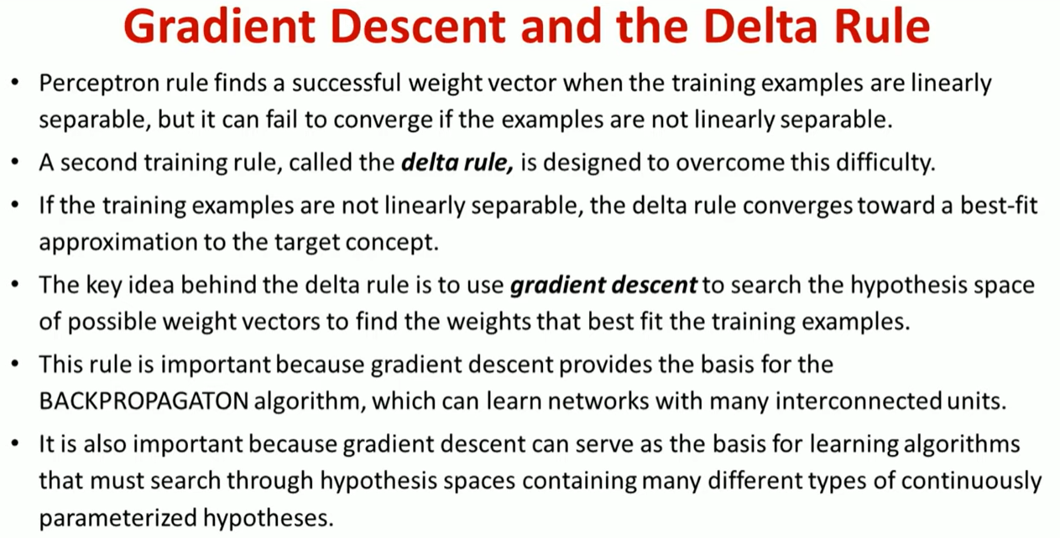

Slide 10
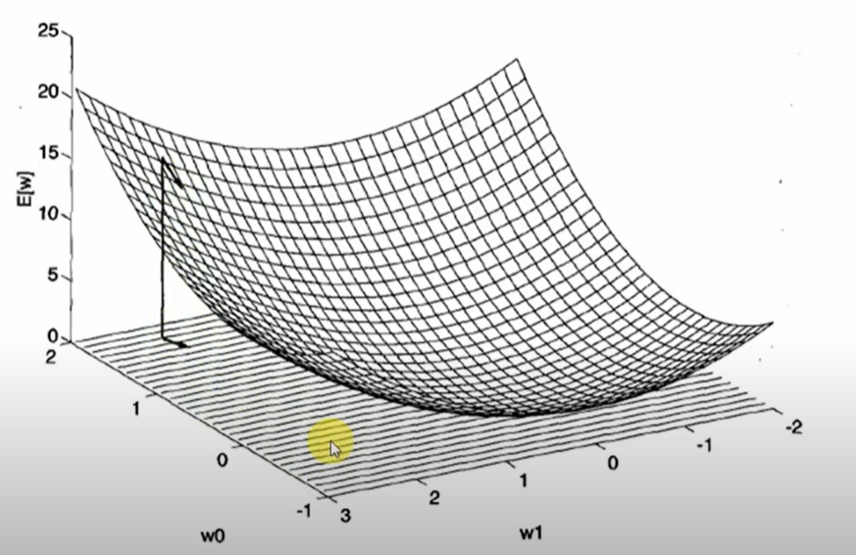
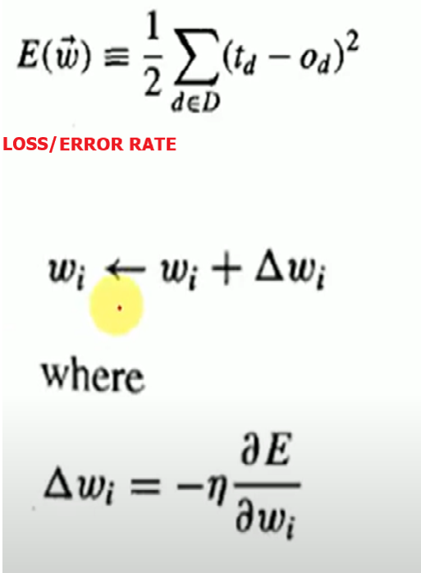
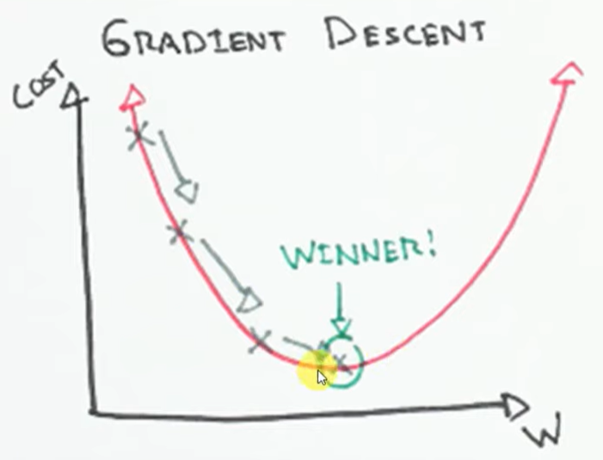
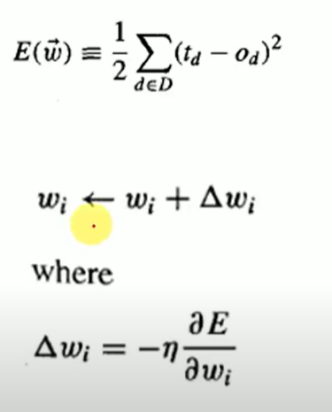

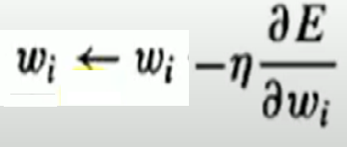


Slide 11
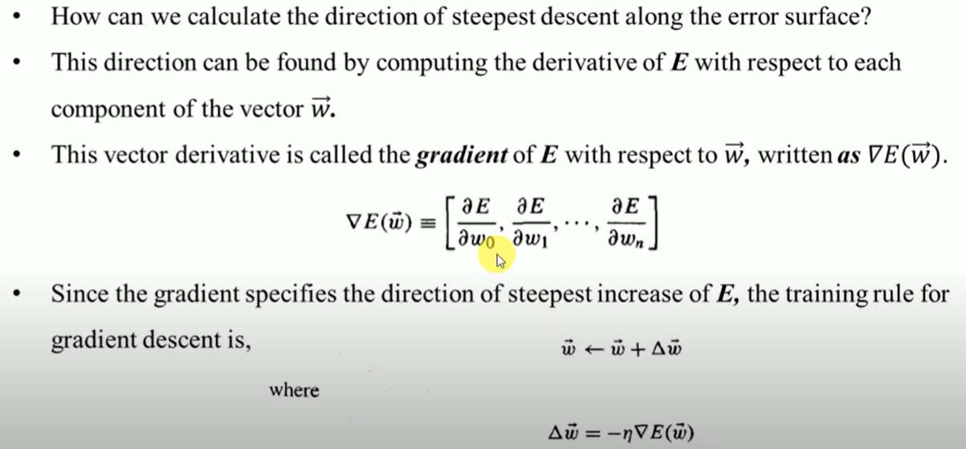

Slide 12
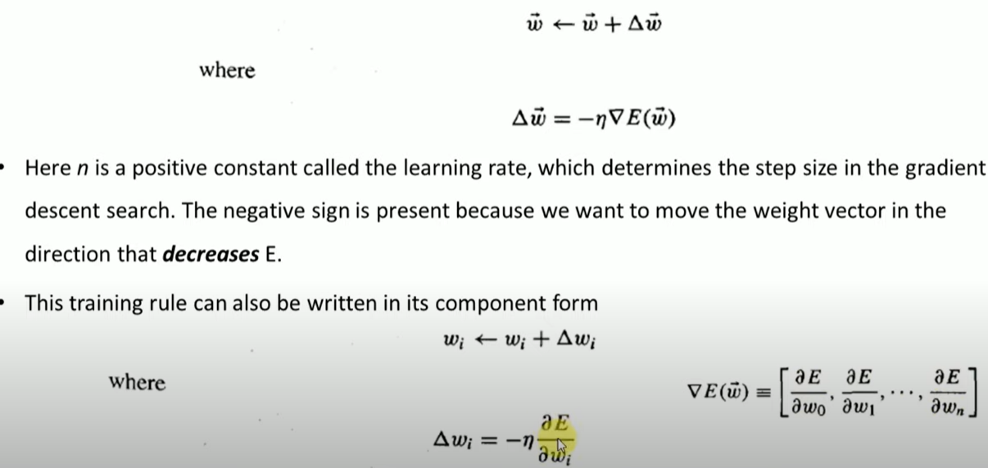

Slide 13
Gradient Descent
Stochastic Gradient Descent

Slide 14
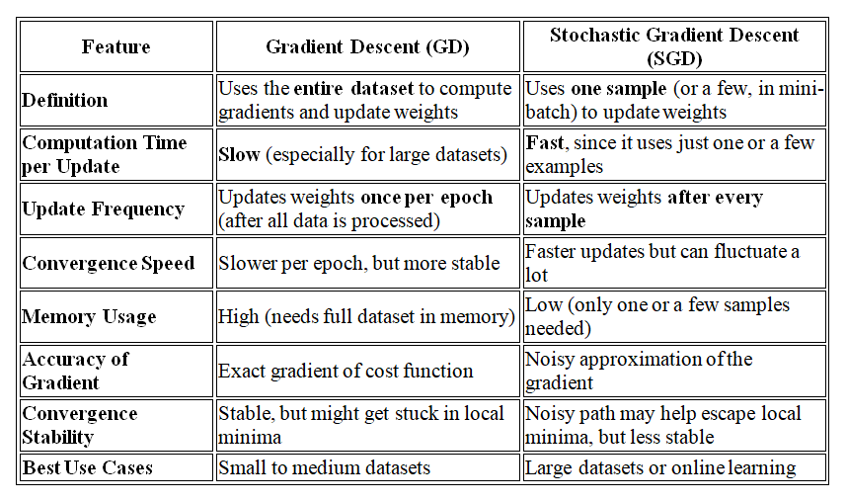

Slide 15
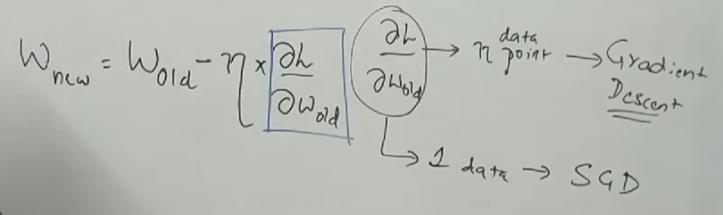
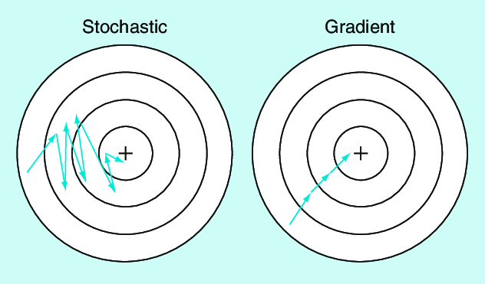
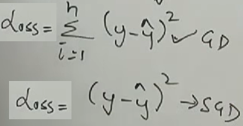
SGD: Takes a zigzag, noisy path, but may reach the minimum faster. | GD: Follows a smooth, straight path downhill.

Slide 16
Back propagation

Slide 17
Backpropagation- Algorithm
Backpropagation is a dynamic algorithm in the training of artificial neural networks, enabling them to learn complicated patterns and relationships inside data.
The system starts off evolved with an ahead skip, where input statistics traverse through the network, undergoing weighted summations and activation features at each layer.
The computed output is then compared to the real target values, generating a loss that quantifies the gap. In the subsequent backward pass, the gradient of the loss with an appreciation of the network's weights and biases is calculated with the use of the chain rule of calculus.
The objective of backpropagation is to minimize the error (or loss) between the predicted output of a neural network and the actual target output. This is achieved by systematically adjusting the weights of the network connections to make the network’s predictions more accurate over time.

Slide 18
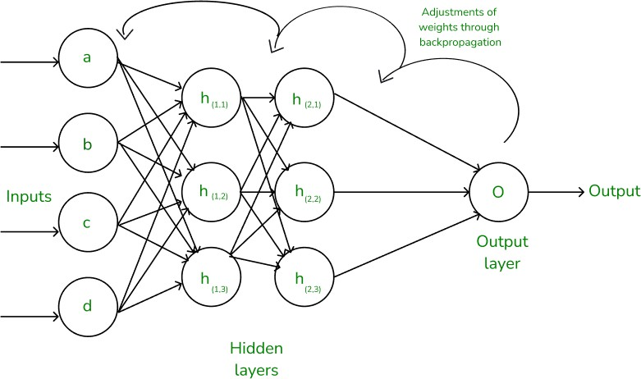

Slide 19
In Deep learning, backpropagation is an effective algorithm used to train artificial neural networks, especially in feed-forward neural networks.
Backpropagation is an iterative algorithm, that helps to minimize the cost function by determining which weights and biases should be adjusted.
During every epoch, the model learns by adapting the weights and biases to minimize the loss by moving down toward the gradient of the error.
Thus, it involves the two most popular optimization algorithms, such as gradient descent or stochastic gradient descent.
Computing the gradient in the backpropagation algorithm helps to minimize the cost function and it can be implemented by using the mathematical rule called chain rule from calculus to navigate through complex layers of the neural network.

Slide 20
Some problems in ANN Optimization and Regularization: Over fitting and Capacity, Cross Validation, Feature Selection, Regularization, Hyper parameters

Slide 21
Capacity, Over fitting, and Under fitting
In deep learning, capacity refers to a model's ability to learn complex patterns from data. It essentially determines how well a model can fit various functions and capture intricate relationships within a dataset. A model's capacity is influenced by its architecture (number of layers and nodes) and the amount of data it's trained on.
Deep learning models aim to perform well on both training data and new, unseen data and is considered "good" if:
It learns patterns effectively from the training data.
It generalizes well to new, unseen data.
It avoids memorizing the training data (overfitting) or failing to capture relevant patterns (underfitting).
To evaluate how well a model learns and generalizes, we monitor its performance on both the training data and a separate validation or test dataset which is often measured by its accuracy or prediction errors.
Two common issues that affect a model's performance and generalization ability are overfitting and underfitting.
These problems are major contributors to poor performance in machine learning models.

Slide 22
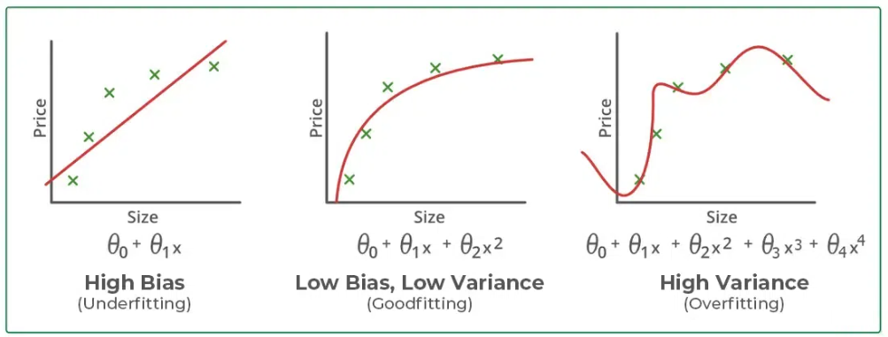
Reasons for Overfitting:
High variance and low bias.
The model is too complex.
The size of the training data.

Slide 23
Cross-Validation in DL
Cross validation is a technique used in Deep learning to evaluate the performance of a model on unseen data.
It involves dividing the available data into multiple folds or subsets, using one of these folds as a validation set, and training the model on the remaining folds.
This process is repeated multiple times, each time using a different fold as the validation set.
Finally, the results from each validation step are averaged to produce a more robust estimate of the model’s performance.
Cross validation is an important step in the machine learning process and helps to ensure that the model selected for deployment is robust and generalizes well to new data.

Slide 24
Cross-validation is a technique for evaluating DL models by training several DL models on subsets of the available input data and evaluating them on the complementary subset of the data. Use cross-validation to detect overfitting, ie, failing to generalize a pattern.
Why do we need cross-validation?
Cross Validation is commonly used in Deep Learning to compare different models and select the most appropriate one for a specific problem. It is both easy to understand, easy to implement, and less biased than other methods.
Purpose of cross validation in machine learning
The purpose of cross–validation is to test the ability of a Deep learning model to predict new data.
It is also used to flag problems like overfitting or selection bias and gives insights on how the model will generalize to an independent dataset.

Slide 25
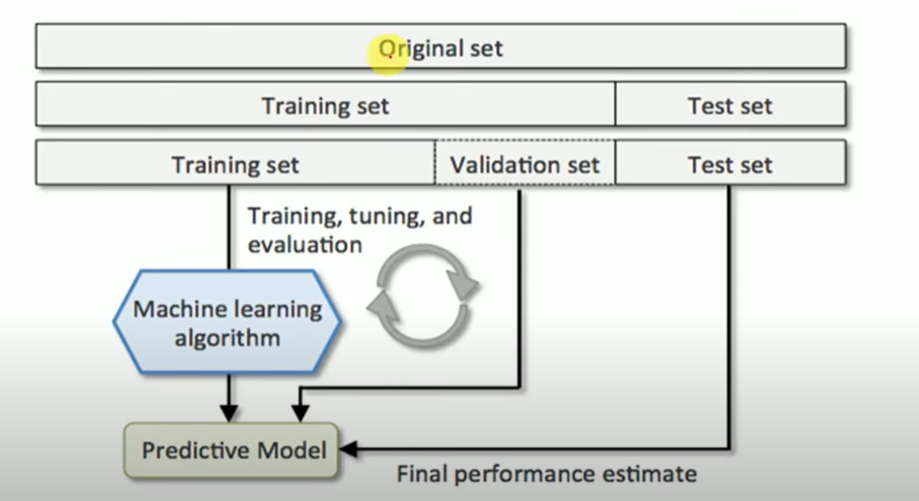

Slide 26
Common Types:
K-Fold Cross-Validation: The most common type, where the data is divided into 'k' folds.
Stratified K-Fold Cross-Validation: Ensures that each fold maintains the same proportion of target classes as the original dataset, which is crucial for imbalanced datasets.
Leave-One-Out Cross-Validation (LOOCV): A special case of k-fold where k equals the number of data points, meaning each data point serves as the validation set once. This is computationally expensive for large datasets.

Slide 27
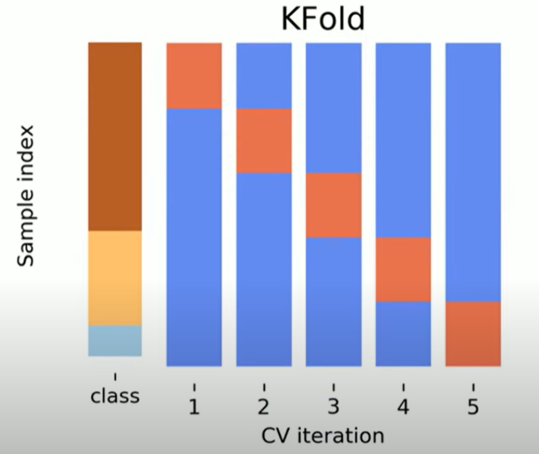
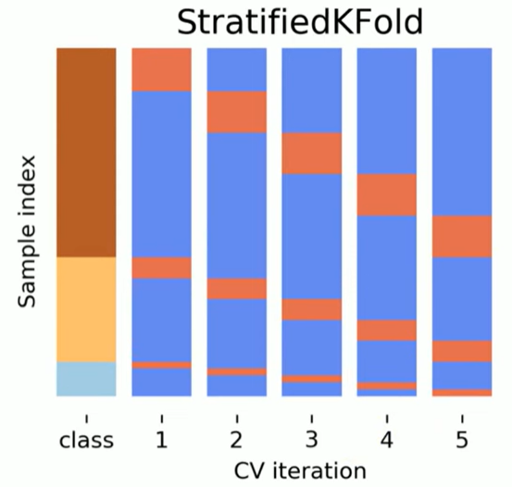
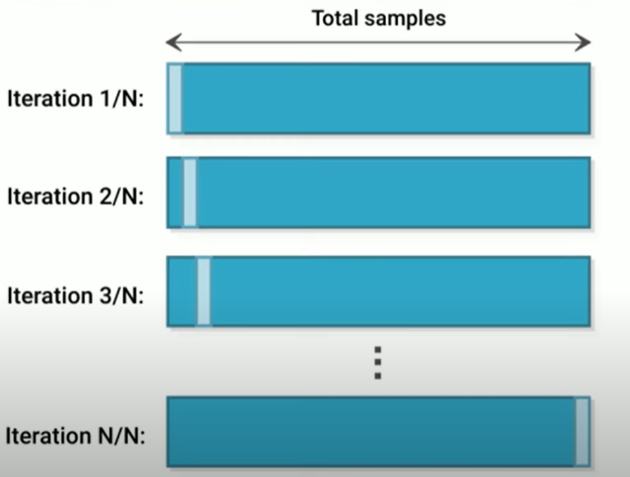

Slide 28
Feature Selection :
Feature selection refers to the process of identifying and using only the most relevant input features (variables) for training a deep learning model.
Although deep learning models can automatically learn which features matter most feature selection is still important.
because it can:
Improve model performance.
Reduce training time and overfitting.
Make the model more interpretable.
Benefits of Feature Selection:
Reduced Overfitting:
Eliminating irrelevant or redundant features can prevent the model from learning noise in the data, leading to better generalization on unseen data.

Slide 29
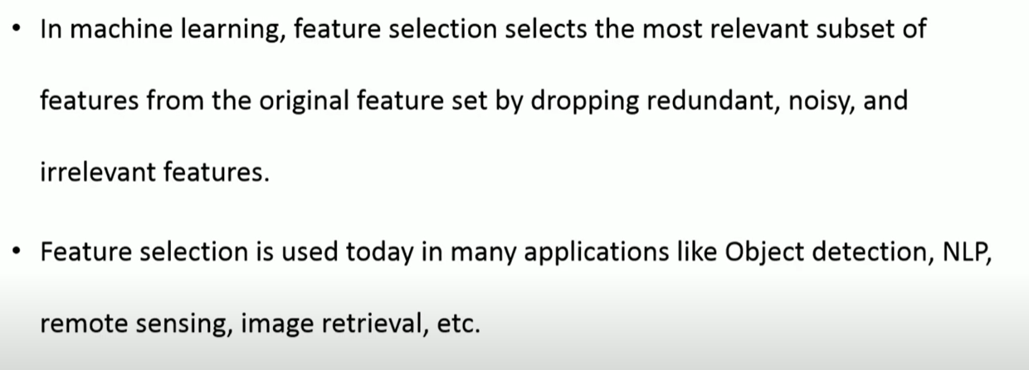
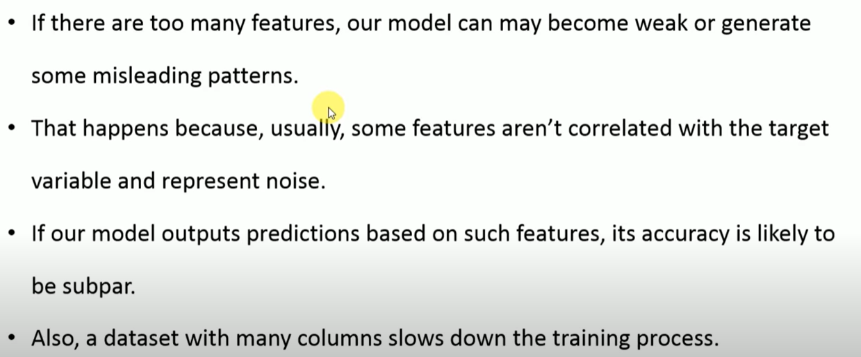

Slide 30
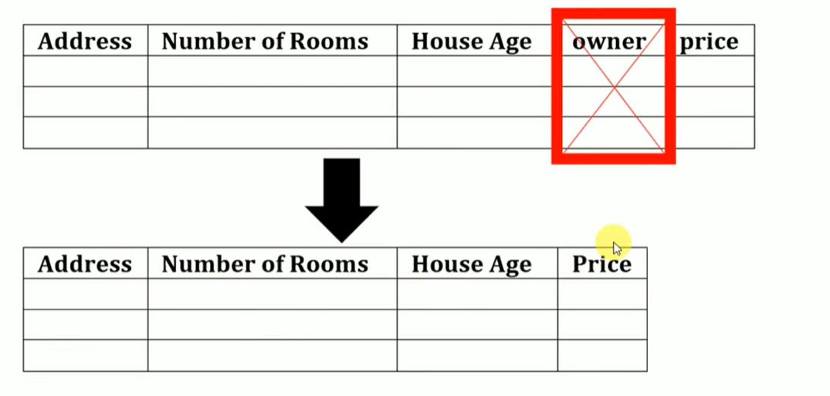
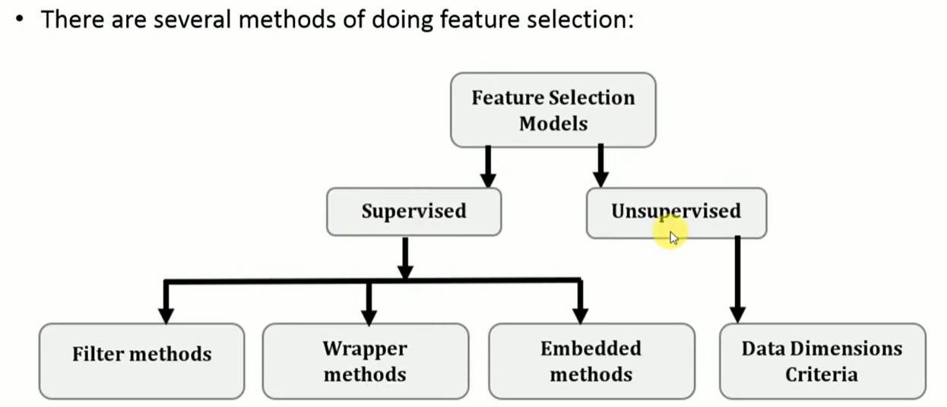

Slide 31
Methods of Feature Selection in Deep Learning:
While traditional feature selection methods (filter, wrapper, embedded) can be applied, deep learning also offers specific approaches:
1) Filter Methods:
These evaluate features independently of the deep learning model, using statistical measures like correlation, mutual information, or chi-squared test to rank features.
2) Wrapper Methods:
These use the deep learning model itself to evaluate subsets of features, such as through recursive feature elimination or sequential feature selection.
3) Embedded Methods:
These integrate feature selection directly into the deep learning model's training process, often through regularization techniques.
.

Slide 32
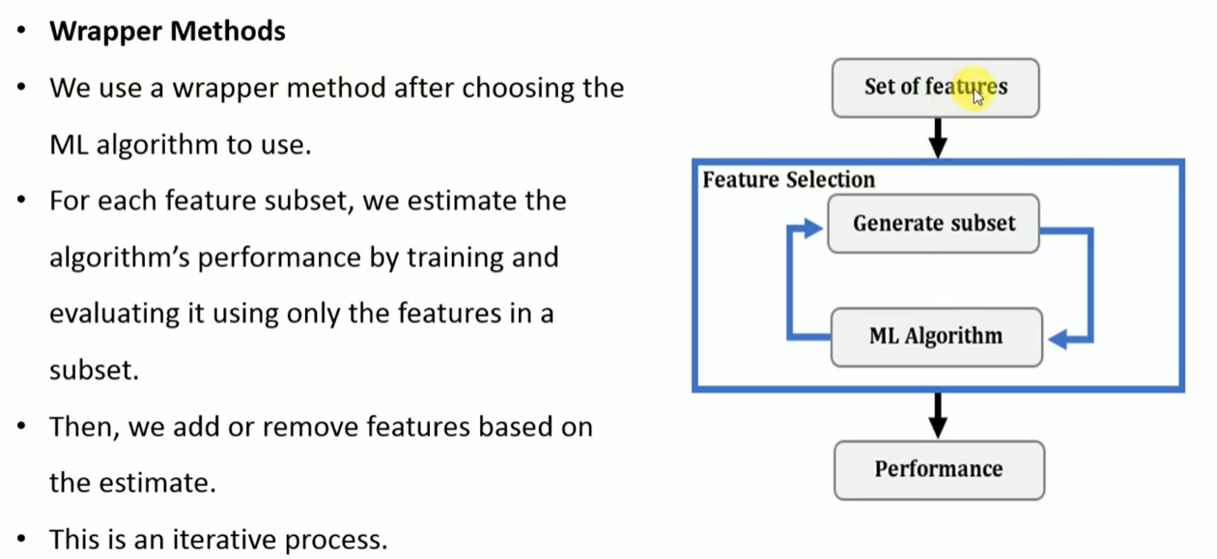
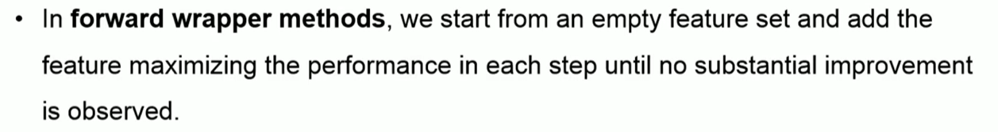
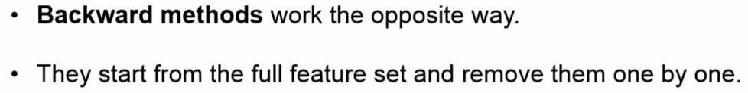

Slide 33
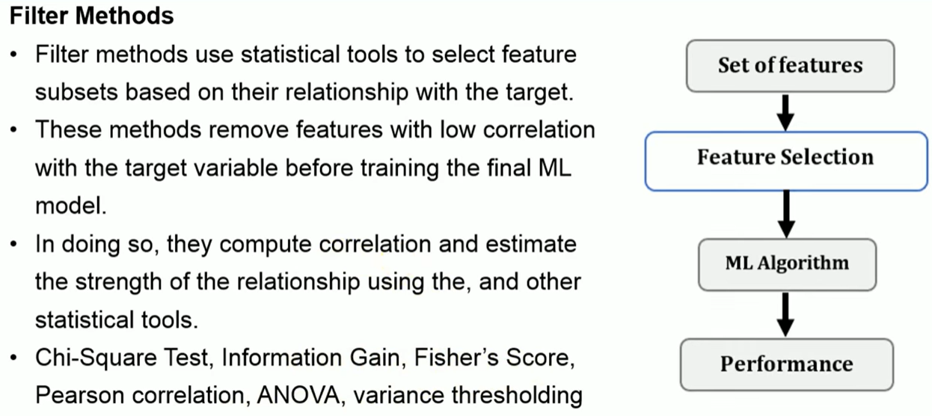

Slide 34
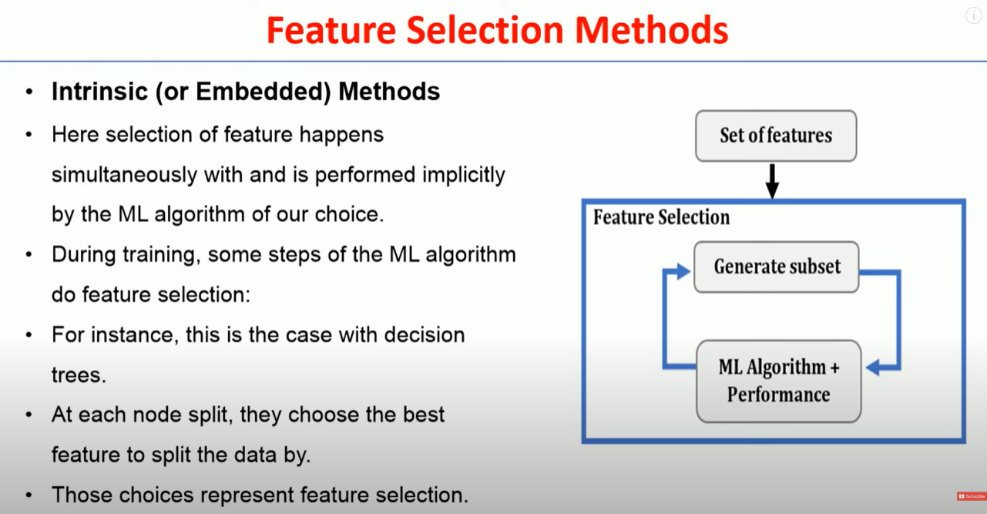

Slide 35
Regularization
Regularization is a set of techniques used to reduce overfitting in deep learning models.
Overfitting occurs when a model performs well on training data but poorly on unseen test data.
Regularization adds constraints or penalties to the learning process so that the model learns simpler functions that generalize better.
Use of Regularization
Deep neural networks have:
Millions of parameters
High capacity to memorize training data
Without regularization, they can overfit, meaning:
High training accuracy
Poor test accuracy (low generalization).

Slide 36


Common Regularization Techniques in Deep Learning
L1 Regularization (Lasso Regression):
Adds a penalty term to the loss function proportional to the “absolute value of magnitude” the model's weights. This encourages sparsity by driving some weights to zero(penalizing), effectively performing feature selection.
L2 Regularization (Ridge Regression):
Adds a penalty term to the loss function proportional to the “squared magnitude” of the model's weights. This encourages smaller, yet non-zero, weights, preventing individual weights from becoming excessively large.
Dropout:
Randomly deactivates a percentage of neurons during each training iteration. This prevents neurons from co-adapting too much and forces the network to learn more robust features.

Slide 37
Early Stopping:
Monitors the model's performance on a validation set during training and stops the training process when the validation performance starts to degrade, indicating potential overfitting.
Data Augmentation:
Increases the diversity of the training data by applying various transformations (e.g., rotations, flips, scaling) to existing samples. This exposes the model to a wider range of variations, improving its ability to generalize.
Batch Normalization:
Normalizes the inputs of each layer within a mini-batch during training. This helps stabilize the training process and can act as a form of regularization by reducing the internal covariate shift.

Slide 38
Hyperparameters
Hyperparameters are settings you choose before training your deep learning model. They control how the model learns, not what it learns.
They are not learned from the data. You set them manually or using search techniques like grid search or random search.
In deep learning, hyperparameters are configuration variables set before training begins, which guide the learning process and model architecture.
They are distinct from parameters (like weights and biases), which are learned during training.
Essentially, hyperparameters define how the model learns, while parameters are what the model learns.
Examples of Hyperparameters:
Learning rate: Controls how big the steps are during optimization.
Batch size: How many samples the model sees before updating weights.
Number of epochs: How many times the model sees the entire dataset.
Number of layers and units per layer in a neural network.
Dropout rate: Fraction of neurons randomly turned off during training to prevent overfitting.

